Slide 1
Intelligent Survivor Locator (ISL)
Ashmita Raju Ramya Ramanathan Sai Gowri Kumar Samyak Upadhyay Surbhi Bakhtiyar

Slide 2
Problem Statement
In the case of a disaster, the main issue faced is the loss of network and electricity.
Limited mobile connectivity due to damaged mobile towers
Victims stranded with no food and water

Slide 3



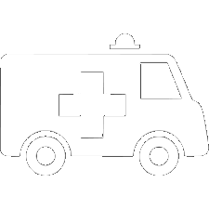

Features
Affected areas are identified using satellite images
Red, Yellow, Green – depending on severity of damage
Determination of the optimal locations to setup help centres
Types of drones for cost reduction and specialization of tasks
Survey – People detection
Supply – Package delivery
Clustering done to help ambulance routing to take remedial measures
UI for central health center manager

Slide 4
Design Flow
Satellite Image
Affected Area Identification
Determining location
of health camps
Determine Survey
Drone Path
Person Detection
Detection of undamaged roads
Clustering to route ambulances
Determine Supply
Drone Path

Slide 5
Technologies Used
OpenCV
Object Detection
IBM Db2 Database
Clustering
Python Flask based Web App

Slide 6

USP
End to end solution works without network
Determining Health Centre Location
Two types of drones to reduce costs
Efficient Path Determination for Drones

Slide 7

Thank You

